Slide 1


Better View with Vue

Slide 2


Frontend & Backend

Slide 3


Kenapa VueJS istimewa ?

Slide 4
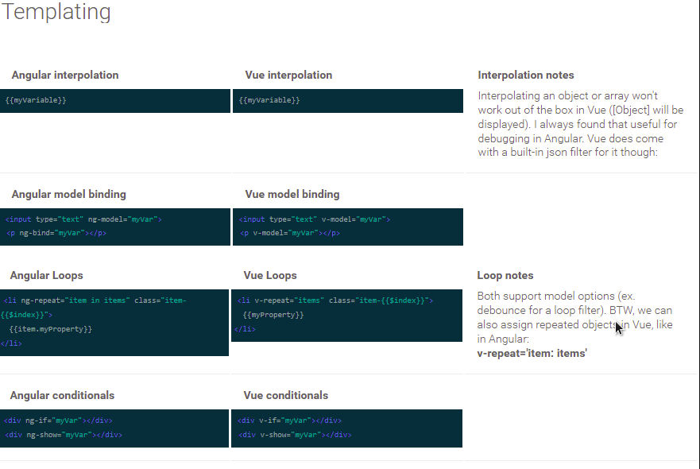
AngularJs Vs Vue

Slide 5
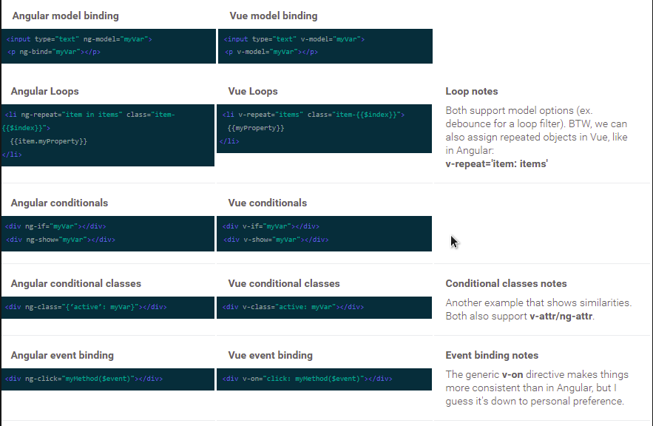
AngularJs Vs Vue

Slide 6
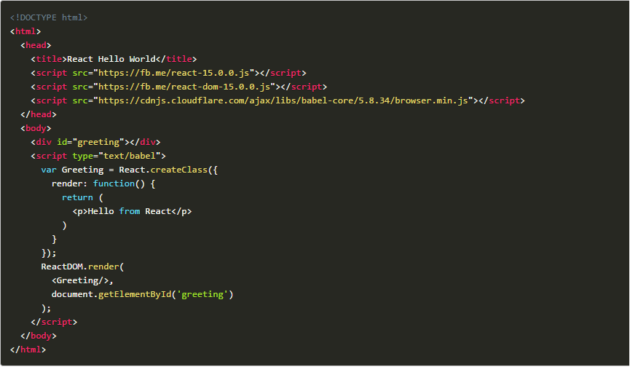
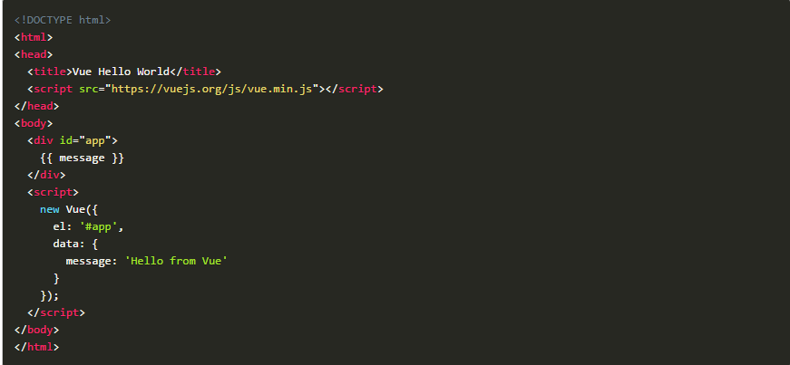
React Vs Vue "Hello World"

Slide 7
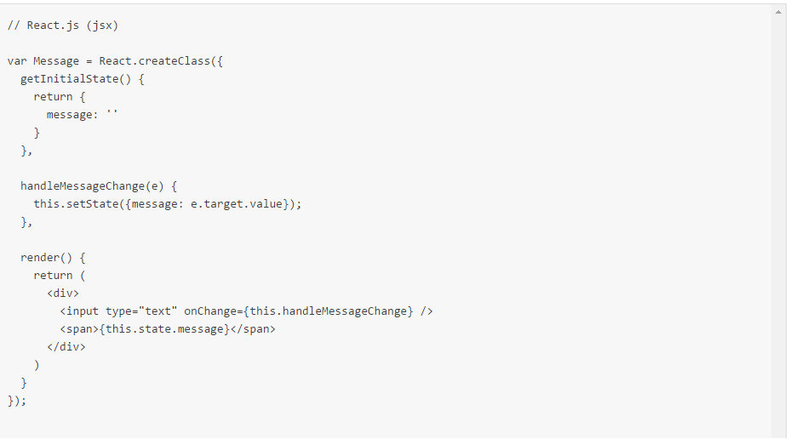
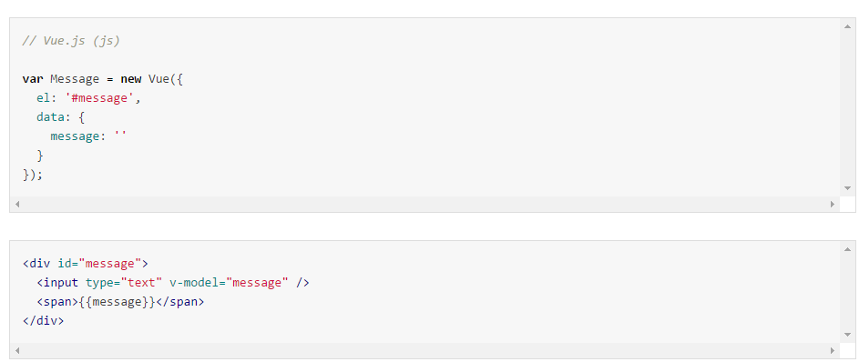
React Vs Vue "Two Way Data Binding"

Slide 8
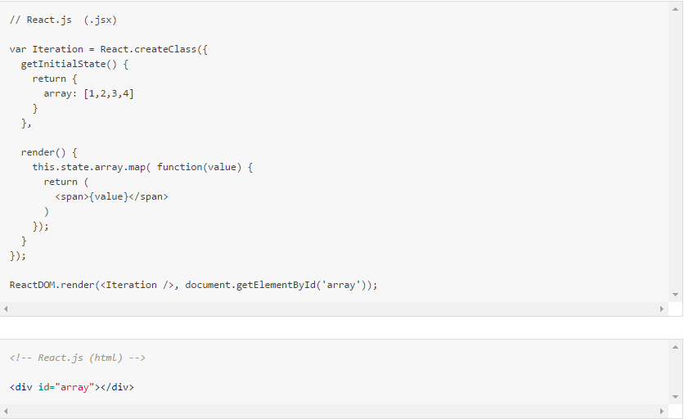
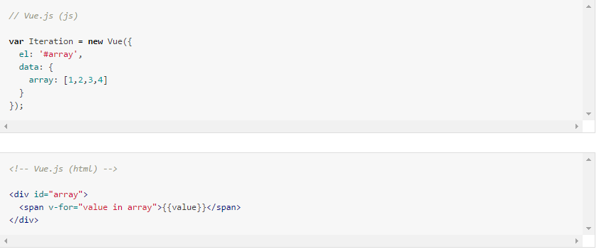
React Vs Vue "Iteration"

Slide 9






Pengguna VUE JS

Slide 10
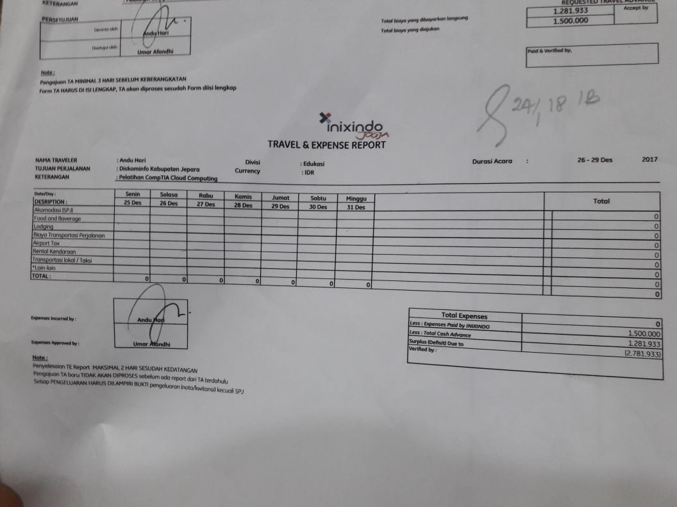
Coding to solve problem

Slide 11
Lets Code

